Slide 1

Functional Programming: Theory to Implementation

Slide 2
Outline
What is Functional Programming?
Programming Paradigms
Imperative vs. Declarative
Paradigm Hierarchy
Lambda Calculus: The Inspiration for Functional Programming
The Birth of Functional Programming
Functional Programming Characteristics
A Short Introduction to Functional Programming Video
Immutable Data
Pure Functions
First-Class Functions & Higher-Order Functions
Lazy Evaluation
Recursion
Manipulation of Lists
Anonymous Functions
Lambda Functions
Map, Filter and Reduce
Closing Remarks & Resources

Slide 3
What is functional programming?
Functional programming has received quite a bit of attention lately, with many modern programming languages implementing functional programming functionalities
Functional programming is a programming paradigm where programs are constructed by applying and composing functions; functional programming treats computation as the evaluation of mathematical functions and avoids changing-state and mutable data
In order to understand this definition, it is important that we understand programming paradigms, the meaning of “applying and composing” functions, how we have come to understand computation and how this all differs from the styles of programming we are familiar with
Notes:
Functional programming has received quite a bit of attention lately, with many modern programming languages implementing functional programming aspects and others declaring themselves “functional languages” altogether
But this begs the question, what is functional programming???
Functional programming is a programming paradigm where programs are constructed by applying and composing functions; functional programming treats computation as the evaluation of mathematical functions and avoids changing-state and mutable data
This definition leaves us with more questions than answers: what is a programming paradigm? What does it mean to apply and compose functions? What is meant by changing state and mutual data?
In order to understand this definition, it is important that we understand programming paradigms, the meaning of “applying and composing” functions, how we have come to understand computation and how this all differs from the styles of programming we are familiar with

Slide 4


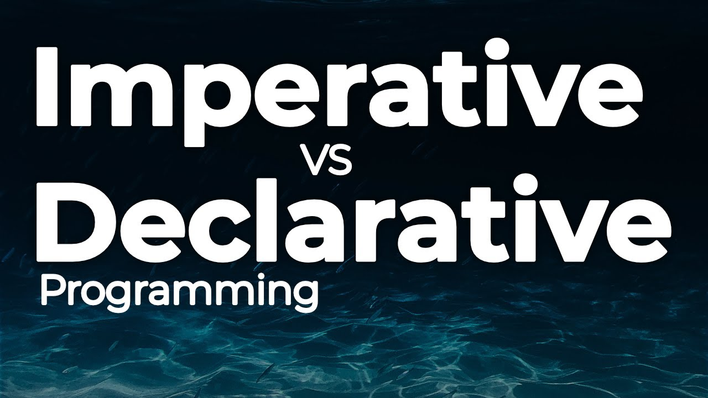
Programming paradigms
Programming paradigms are a way to classify programming languages based on their features
You can think of programming paradigms as “styles” of building programs, which can be classified into two main groups: imperative and declarative.

Slide 5
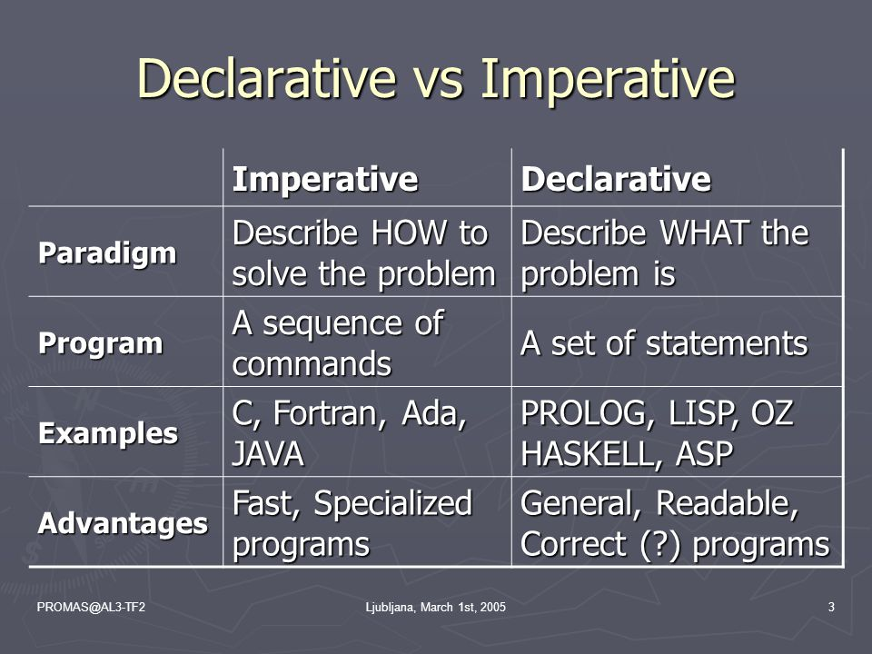
Imperative vs. declarative
Imperative programming is a paradigm in which the programmer tells the program how to solve a problem explicitly
In declarative programming, the programmer describes what the problem is through a set of statements, but does NOT tell the program how to solve it

Slide 6
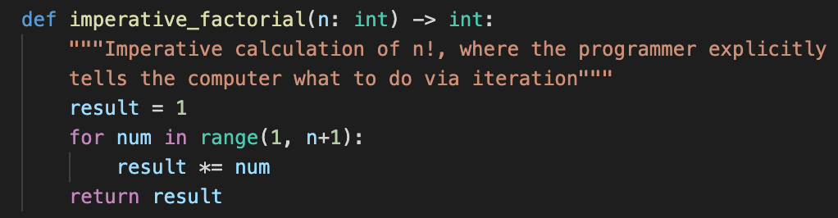
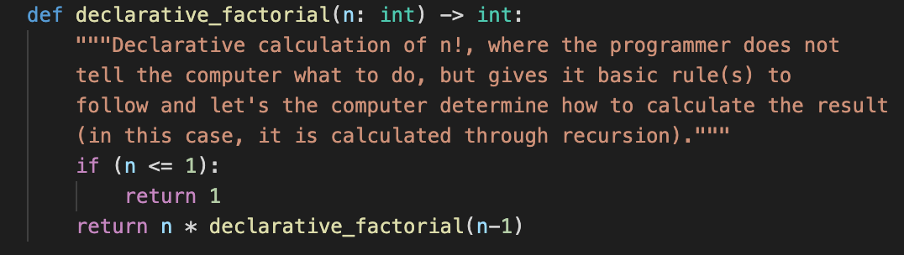
A look at imperative Vs. declarative code
The code snippets on the right consist of two different ways to calculate the factorial of a number: the one on top is imperative and the bottom one is declarative
In the imperative case, we are explicitly telling the program what to do
In the declarative case, we stated the ”base case” for recursion, or more simply a rule. We allow the function to keep calling itself until the problem is solved

Slide 7
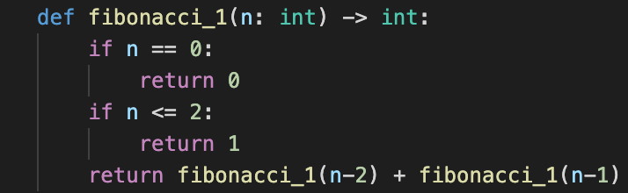
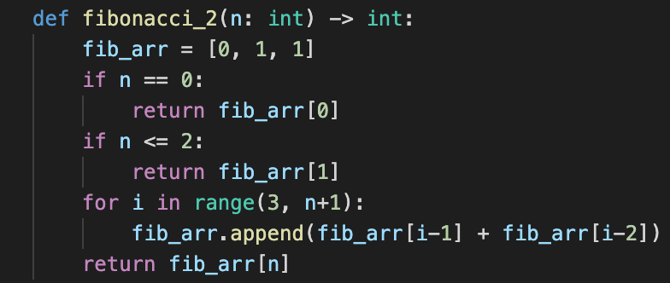
Exercise: Which is which?
The Fibonacci_1() function is the declarative way of generating the Fibonacci sequence, as we are simply giving the computer rules to abide by in the form of if statements and letting it figure out how to return the answer. In Fibonacci_2(), we are using a for loop to instruct the operations that the computer should carry out to compute the result; therefore it is imperative.

Slide 8
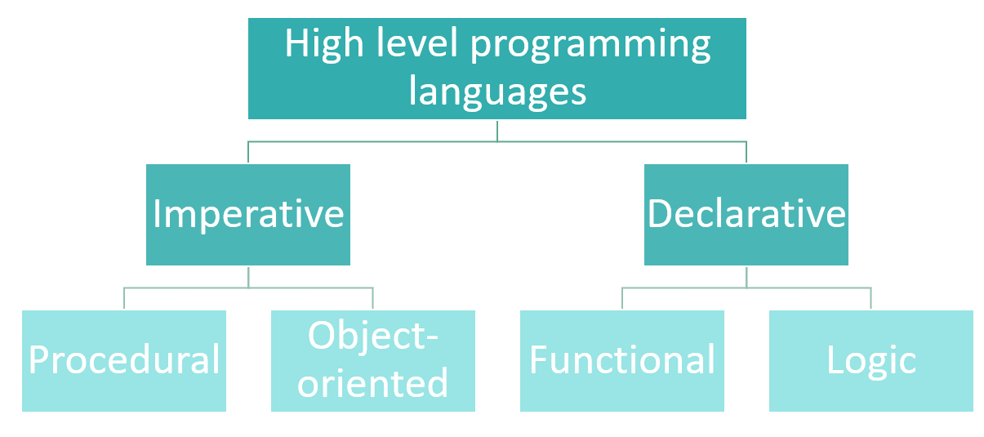
Paradigm hierarchy
Within the imperative and declarative programming paradigms are “sub-paradigms”
The paradigms that we are familiar with, procedural and object-oriented, fall under the imperative paradigm.
Many programmers find it hard to work with functional programming for this reason
To get a better understanding, let’s learn about the philosophy that drives functional programming
Notes:
Within the imperative and declarative programming paradigms are “sub-paradigms”
Procedural programming divides a program into “procedures” (better known as functions), wherein the program uses these functions to run from the top down
Object oriented programming organizes a program around data to be represented by classes; these classes define how one can access and modify these instances of data, called objects
Both these paradigms fall under imperative programming, so what about those falling under declarative?
In other words, what about functional programming???

Slide 9
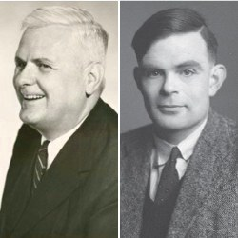
Lambda calculus: the inspiration for functional programming
In the 1930s, mathematician Alonzo Church developed lambda calculus, a formal system for expressing computation
Around the same time, Alan Turing developed his own model of computation known as the Turing machine
Lambda calculus can be used to compute anything that a Turing machine can and vice versa, which means that these systems can do anything a modern computer can!
Notes:
In the 1930s, mathematician Alonzo Church developed lambda calculus, a formal system in mathematical logic for expressing computation
Around the same time, Alan Turing developed his own model of computation known as the Turing machine, also known as the classical computer
Lambda calculus can be used to compute anything that a Turing machine can and vice versa, which means that these systems can do anything a modern computer can

Slide 10
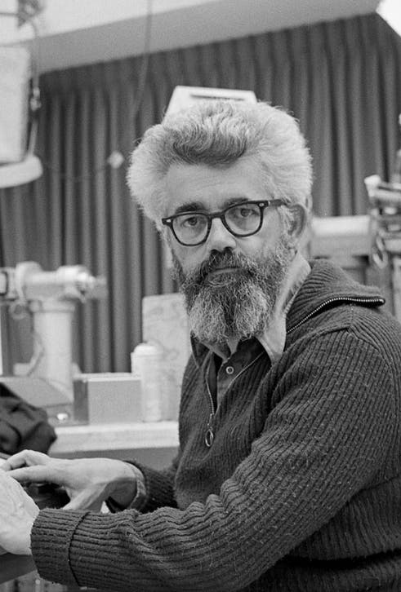
The birth of functional programming
While many developed imperative programming languages like COBOL, C, C++ and Java in the 20th century, others developed declarative ones like LISP, Prolog, Haskell and Erlang
One notable computer scientist who applied the teachings of Lambda calculus was John McCarthy (left), who developed LISP in the late 1950s
The creation of LISP marked the birth of functional programming, and a new way of thinking about writing programs

Slide 11
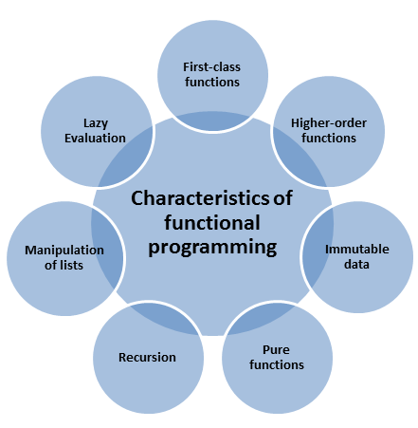
Functional programming Characteristics
It is important to adhere to the characteristics of functional programming, as they rely on each other to function properly
To get a good overview of these characteristics and the principles of functional programming, let’s watch a short video

Slide 12
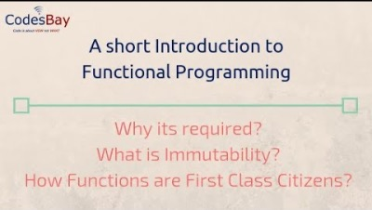

Slide 13

Immutable data
Data stored on a computer falls into one of two categories: mutable or immutable.
Mutable data can be deleted or modified, immutable data cannot
For an example, declaring a variable as “final” in Java prevents you from altering its state: this is what all data is like in functional programming
Though it sounds strange that all data would be immutable in functional programming, formatting data this way does provide benefits

Slide 14
Benefits of immutable data
Improved readability - code is simpler to understand and reason about due to constant variable states
Improved efficiency – Code becomes quicker to update and more efficient to manage
Traceability - Easily trace how and where your data is changing in the code
Improved safety - Once you’ve verified the state of an immutable object, no process will be able to change it without you knowing
Better caching - You can cache references to immutable objects since they won’t change
Easier testing and debugging - Since the state of your immutable object doesn’t change, it’s much easier to test your code, and track down bugs

Slide 15

Pure functions
A pure function is a function whose output value follows solely from its input values, without any observable “side effects”.
Side effects refers to intended and unintended changes made to other data in the program: modifying and deleting any data in the program is prohibited
Furthermore, pure functions will run identically for given input value(s)
Deviation from the principle of data immutability would allow functions to produce side effects

Slide 16
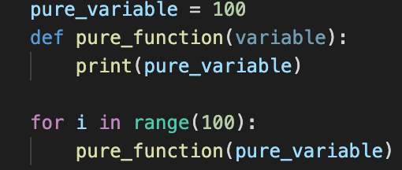
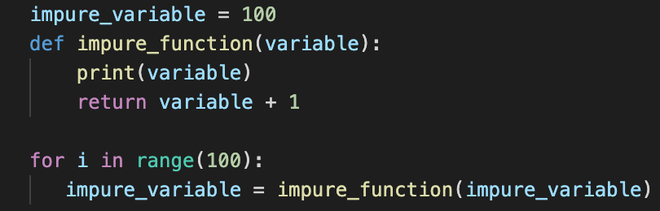
Pure function example
The first code snippet shows a pure function, where pure_variable is treated immutable and pure_function() produces the same output with the same input. No side effects occur, no data mutated or deleted.
The second code snippet shows an impure function, where impure_variable is incremented as a result of running impure_function(). Data is modified during the run of the function, side effects occur and the same input variable produces a different output.

Slide 17
First-class functions & Higher order functions
Two of the main characteristics of functional programming are the treatment of functions as “first-class functions”, meaning they can be treated as variables, and the ability to construct ”higher order functions”, which are functions that can take functions are parameters and return them
Without first-class functions, we lose the ability to create higher order functions, and first-class functions lose viability when higher order functions cannot be constructed.

Slide 18
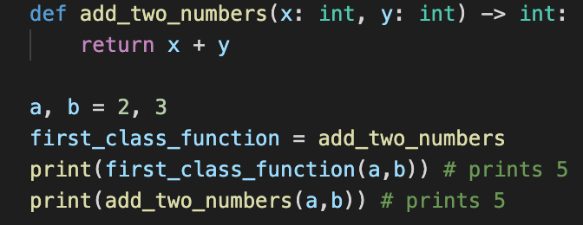
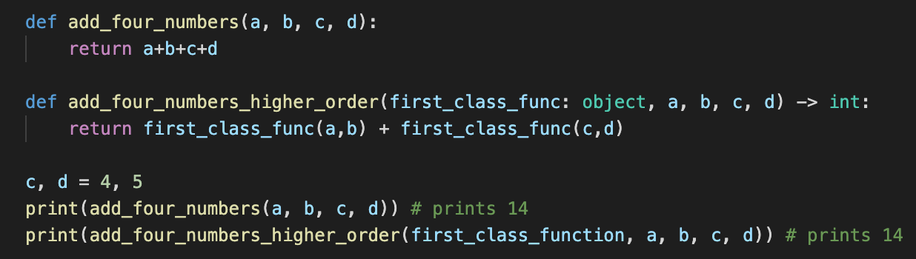
Examples
In the example to the left, we illustrate the use of a first-class function to add two numbers. We can see that the regular function call and the call using a first-class function yield the same result
In the above example, we illustrate the use of a higher order function to add four numbers, which takes in our previously defined first-class function for adding two numbers.

Slide 19


Lazy evaluation
Lazy evaluation is an evaluation strategy which holds the evaluation of an expression until its value is needed. It avoids repeated evaluation.
In short, it means only evaluate expressions when necessary
Strengths: Reduced time complexity, runtime optimizations
Weaknesses: Possibly increased space complexity
lazy evaluation is only possible in a declarative language like functional programming; imperative languages have no alternative

Slide 20

Recursion
Iteration is not a concept in functional programming, since it requires updating variables to keep count, and therefore isn’t used
Recursion, then, is one of the main strategies used to traverse a list
recursion is self-reliant in the way that it solves problems: it merely requires the repeated application of a function for computation.

Slide 21
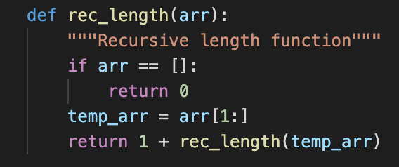
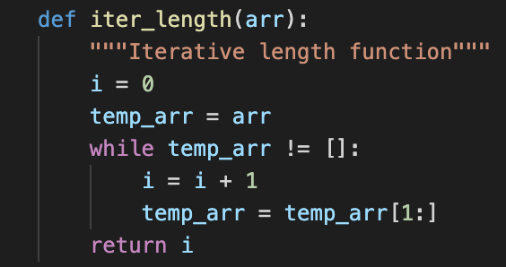
Recursion: example
We see here again the difference between a recursive solution, though this time focus on how our array changes: in the case of recursion, we are generating a new array for each function call (since we must ensure data immutability). When using a for loop, we do our work “in-place”.

Slide 22
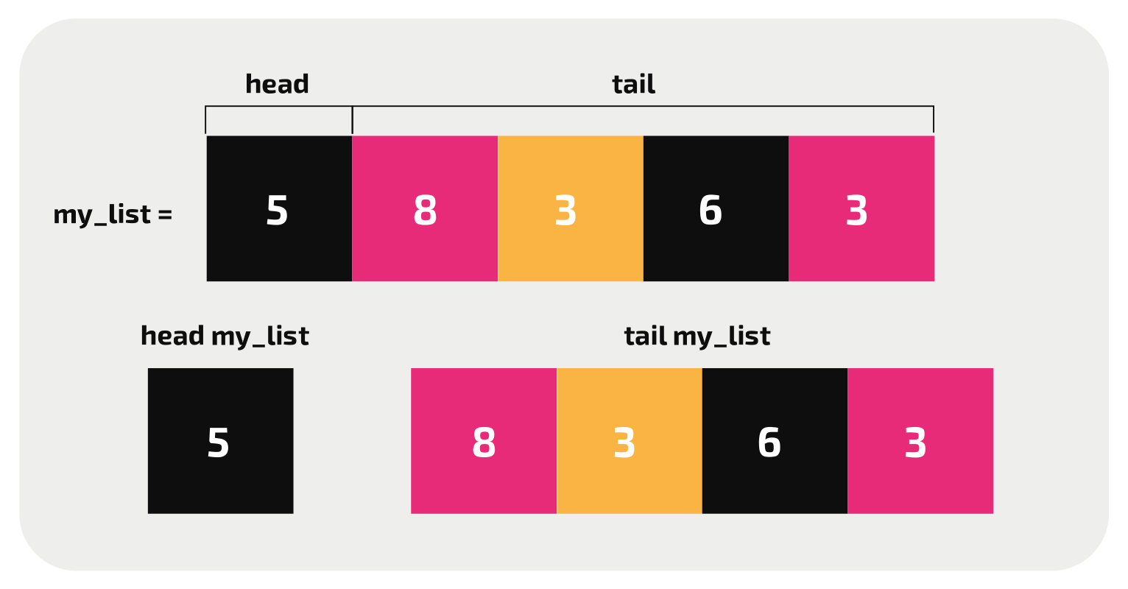
Manipulation of lists
In functional programming, the manipulation of lists is integral for many operations
Along with recursion, the manipulation of lists is the other main strategy for traversal
The two main concepts of list manipulations are the head (the first element in your list) and the tail (the rest of the list)
Diagram of list as seen in functional programming languages

Slide 23
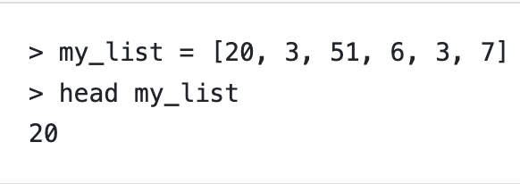
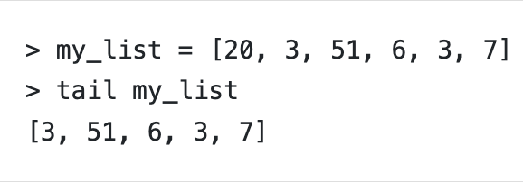
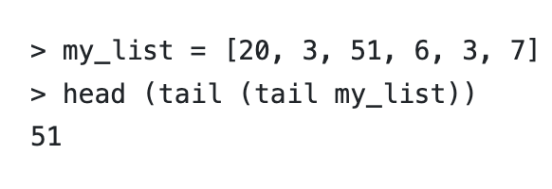
Example: manipulation of lists
To the right are some examples of list manipulations in Haskell
We can see that the head and tail operations return first element and all but the first element respectively
In the bottom example, we can see that we are manipulating these terms to get the third element in the list
This process can be generalized to traverse lists with ease
One important thing to remember is that these operations return new values, since we are not allowed to manipulate data

Slide 24
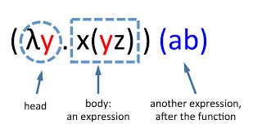

anonymous functions
An anonymous function is a function that does not require a formal definition.
The most widely used anonymous functions are called “lambda functions”, which are based upon the composition of functions is lambda calculus.
A function in lambda calculus has the expression $λx.M(N)$, where $λx$ is the head of the expression, M is the body of the expression and (N) is the expression the function will apply
For example, $λx.x$ is equivalent to the function f(x) = x, and $λx.(y)$is equivalent to f(x)=y
We will use lambda functions to implement some very handy functions: map(), filter() and reduce()

Slide 25
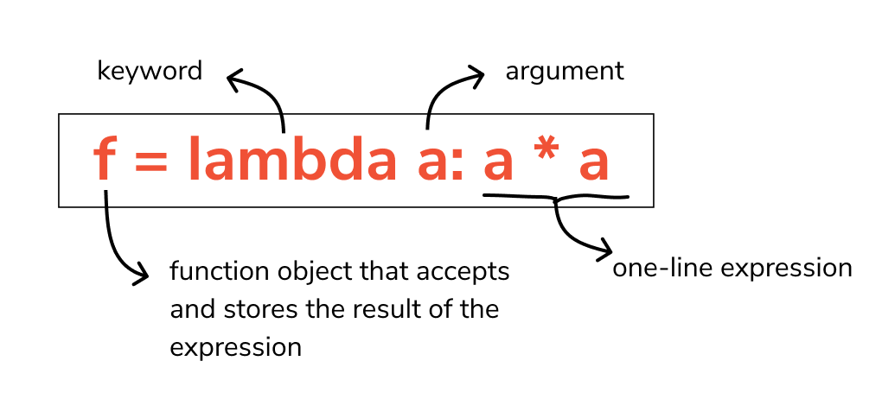
Lambda functions in python
Lambda functions are a great utility in functional programming, as they allow us to define functions on the fly for single use
Let’s look at a few examples of lambda functions in action
The syntax for a lambda expression in Python

Slide 26
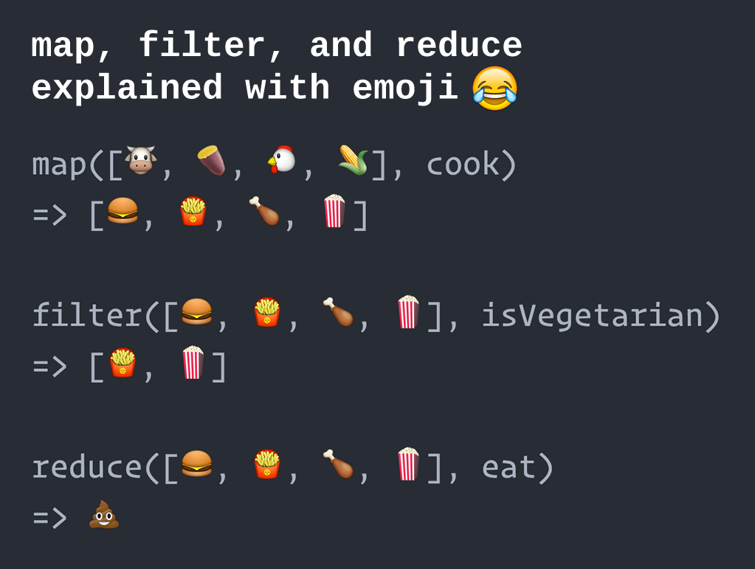
Three powerful functions: Map(), filter() and reduce()
Map(), filter() and reduce() are three extremely useful functions derived from functional programming
In functional languages, they rely on the manipulation of lists to function
Let’s take a look!

Slide 27
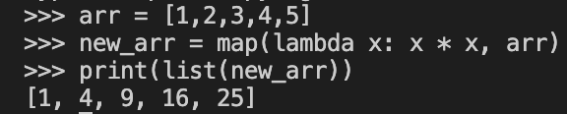
Map()
The map() function iterates through all items in a given iterable / list and executes the function we pass as an argument on each of them.
The syntax of map() is map(function, iterable(s))
Let’s take a look at an example:
Mapping the “square” function onto my list, creating a new list of squared values

Slide 28
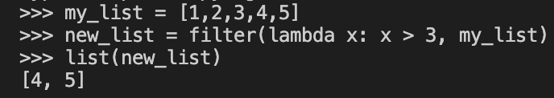
Filter()
filter() forms a new list that contains only elements that satisfy a certain condition, i.e. the function we passed returns True
The syntax is filter(function, iterable(s))
Let’s take a look at an example:
Here, we used the filter() function to generate a new list with the values that satisfy some condition, in this case those values greater than three

Slide 29

Reduce()
reduce() works differently than map() and filter(). It does not return a new list based on the function and iterable we've passed. Instead, it returns a single value.
The syntax is reduce(function, sequence[, initial])
Reduce() is different than map() and filter() in the way it operates, as it uses a technique known as folding, or reduction.

Slide 30
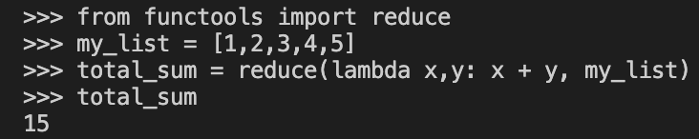
Reduce() continued
The process of folding goes like this: Apply a function (or callable) to the first two items in an iterable and generate a partial result.
Use that partial result, together with the third item in the iterable, to generate another partial result.
Repeat the process until the iterable is exhausted and then return a single cumulative value.
The example to the left shows this process in action, as we use folding to sequentially add the elements!

Slide 31
Closing remarks & resources
At the end of the day, functional programming is simply one of many styles of programming that you can utilize
Functional programming, along with the other programming paradigms, does not have to be all or nothing: any programmer can benefit from the techniques that arise in functional programming
Resources:
https://hackr.io/blog/programming-paradigms
https://hackr.io/blog/functional-programming
https://realpython.com/python-functional-programming/
https://www.youtube.com/watch?v=6RAQynw2Sy8
https://www.youtube.com/watch?v=0if71HOyVjY
https://isaaccomputerscience.org/concepts/prog_func_list?examBoard=all&stage=all
https://python-course.eu/advanced-python/lambda-filter-reduce-map.php

